Slide 1
Stock Market Prediction System
Under the guidance of
Dr. Mrs. Himangi Pande
Group Member Details
Harshali Bedmutha(B150028507)
Ria Garg(B150028525)
Ritika Jain(B150028535)

Slide 2
Contents
Introduction
Problem Statement
Motivation
Objectives
Introduction
Literature Survey
Limitations of existing system
Scope
System Architecture
UML Diagrams
Hardware and Software Requirements
Outcomes
References

Slide 3
Introduction
Stock market prediction is the act of trying to determine the future value of a company stock or other financial instrument traded on a financial exchange.
The successful prediction of a stock's future price could yield significant profit.
In recent years many machine learning algorithms are being explored for accurate predictions of stock.
Some of these include CNN, ANN, LSTM, SVM etc.
This project aims at developing one such system to predict stock values based on historical data.

Slide 4
Problem Statement
Title: “Stock market prediction system using CNN and SVM”
The idea of the project is to develop a system for Stock Market Prediction for various companies listed in National Stock Exchange (NSE).
We use CNN and SVM to construct a model to effectively predict stock prices.
The project takes input the historical and real-time stock data from Yahoo Finance.
The parameter taken into consideration are Open, High, Low, Close, Adjacent Close . We use the above listed features to predict the Closing Price for next day.
We also develop a User Interface with functionalities to Get Quote of a company stock, Get predicted Close Value and visualize the data using graphs.

Slide 5
Motivation
Prediction of stock market price is one of the most important issues in finance.
With a successful model for stock prediction, we can gain insight about market behavior over time, spotting trends that would otherwise not have been noticed.
With the increasingly computational power of the computer, machine learning will be an eﬃcient method to solve this problem.
We can try to improve the accuracy of prediction by modifying the existing systems.

Slide 6
Objectives
To develop a system for accurately predicting stock price using Convolutional Neural Network Architecture(CNN) and Support Vector Machine(SVM)
To determine the best values for pool length, no. of filters, no of hidden layer while construction of the CNN model.
To determine appropriate parameters for SVM.
To achieve higher efficiency in stock prediction.

Slide 7
Literature Survey
Sr. no | Title | Description | Results
1 | Sreelekshmy Selvin, Vinayakumar R, Gopalakrishnan E.A, Vijay Krishna Menon, ‘STOCK PRICE PREDICTION USING LSTM,RNN AND CNN-SLIDING WINDOW MODEL’, International Conference on Advances in Computing, Communications and Informatics (ICACCI),IEEE, Udupi, India, Sept 2017 | Time series analysis of stock data using LSTM, RNN and CNN for two different sectors(IT and Pharma sector) Use of a Sliding Window Approach Prediction made for next 10 minutes Comparison between the methods used (RNN,CNN LSTM) | CNN is proved to be the best in proposed method. CNN uses information given at particular instance for prediction and hence it outperforms the other algorithms.
2 | Luca Di Persio , Oleksandr Honchar ‘Artiﬁcial Neural Networks architectures for stock price prediction: comparisons and applications , 2016 | Use of MLP, CNN, LSTM Normalization od data followed by hyperparameter optimization. Use of wavelets Tree Structured Parzen Estimator(TPE) Principal Component Analysis | PCA produce poor results Use of ensembles provide good result. CNN outperforms the rest.

Slide 8
Sr. no | Title | Description | Results
3 | Avraam Tsantekidis, Nikolaos Passalis, Anastasios Tefas, Juho Kanniainen, Moncef Gabbouj and Alexandros Iosiﬁdis ‘Forecasting Stock Prices from the Limit Order Book using Convolutional Neural Networks’ | Uses a intelligent normalization technique Bid and ask values are used Calculates recall and precision, F1 value | CNN performs better than all algorithms.
4 | Anastasia Borovykh Sander,Bohte, Cornelis W. Oosterle ‘Conditional time series forecasting with convolutional neural networks’ June 2018 | Detailed approach of stock prediction using CNN Uses wavelets Uses concept of dilated convolution | Unconditional wavelets performs best.
5 | M. Karazmodeh, S. Nasiri, and S. Majid Hashemi, ‘Stock Price Forecasting using Support Vector Machines and Improved Particle Swarm Optimization’, Journal of Automation and Control Engineering, North Cyprus, Turkey, June ,2013 | employs an Particle Swarm Optimization (PSO) Improved via Genetic Algorithm (IPSO) based on Support Vector Machines (SVM) | Accuracy around 60% PSO with Genetic Algorithms perform better

Slide 9
Sr. no | Title | Description | Results
6 | Trevor M. Sands, Deep Tayal, Matthew E. Morris, and Sildomar T. Monteiro,’ Robust Stock Value Prediction using Support Vector Machines with Particle Swarm Optimization’, 2015 IEEE Congress on Evolutionary Computation(CEC), IEEE, Sendai, Japan, May 2015 | Comparison of SVM-PSO,ANN, Naïve Bayes High accuracy (95%) | SVM alone perform poor if parameters are not carefully selected. SVM-PSO give higher accuracy
7 | Osman Hegazy, Omar S. Soliman and Mustafa Abdul Salam, ‘A Machine Learning Model for Stock Market Prediction’ , International Journal of Computer Science and Telecommunications , Egypt, December 2013 | Integrates PSO with LS-SVM 13 benchmark financial datasets used compared with artificial neural network with Levenberg-Marquardt (LM) algorithm | ANN performs worst PSO solves probem of over-fiiting PSO helps in better tunig the parameters

Slide 10
Limitations of Existing Systems
Since stock market is a highly dynamic environment, the predictions have not achieved a high accuracy.
Many systems use only SVM. But these systems achieve accuracy nearly 70% which is still low.
So, SVM with CNN produce a higher accuracy (greater than 95% in most cases)
CNN alone or SVM alone are less effective rather than the hybrid approach.

Slide 11
Project Scope
What functionality it coverS
What is not covered
The project aims to predict the stock values for 3 NSE listed companies.
The prediction can be based on day-wise dataset. We use day-wise stock market data and predict for next days rather than minutes.
Graphs based on the stock prices are generated.
Real time data used for purpose of comparison.
Not all NSE listed companies are included
No minute-wise predictions included

Slide 12
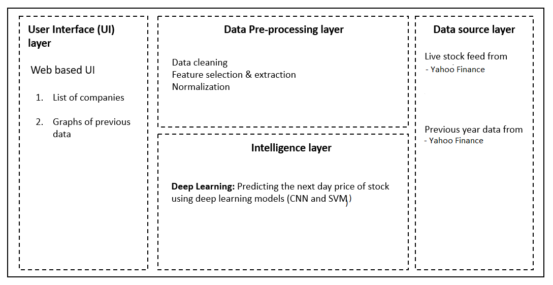
System Architecture
Figure : System Architecture

Slide 13
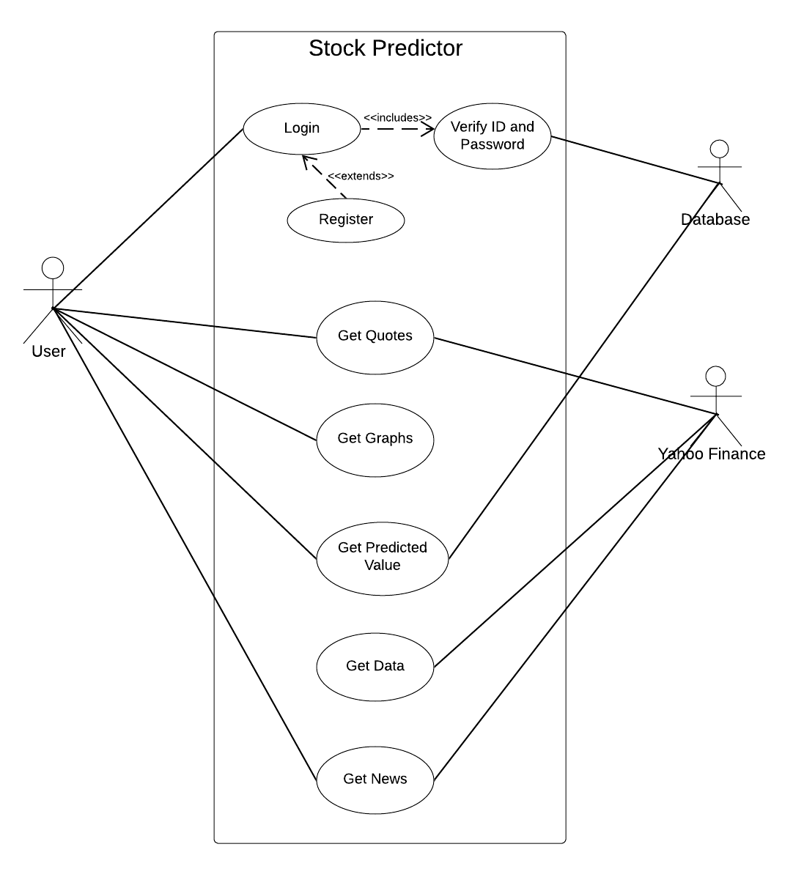
UML Diagrams : Use case

Slide 14
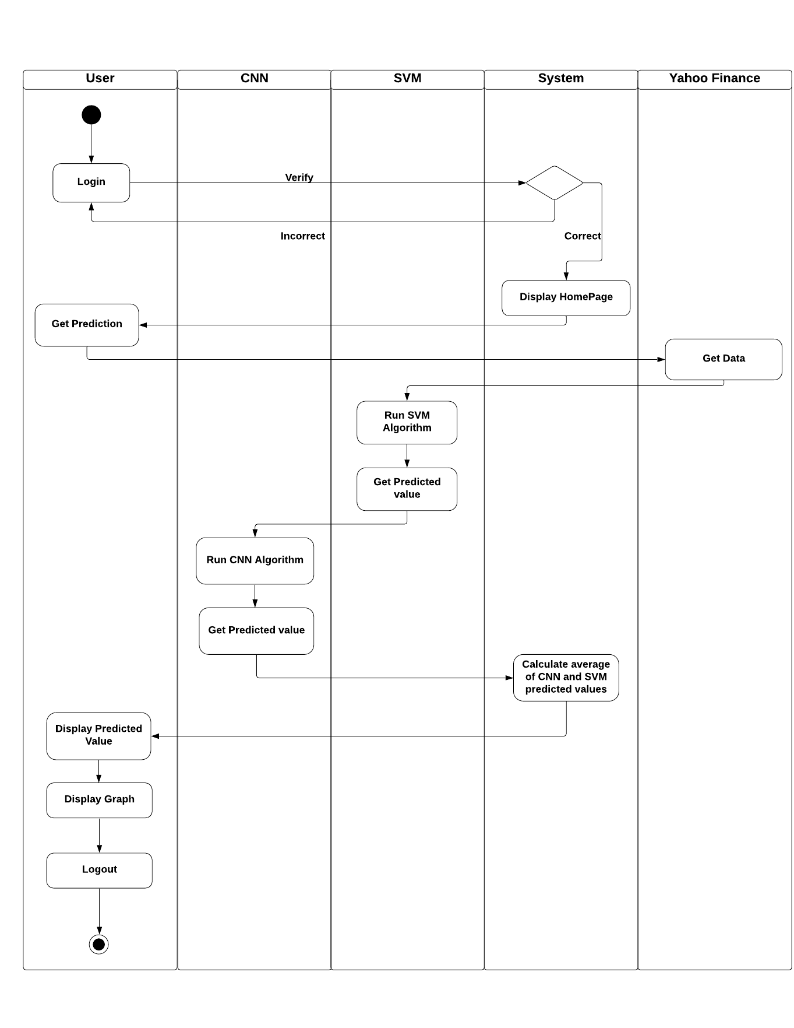
UML Diagrams : Activity

Slide 15
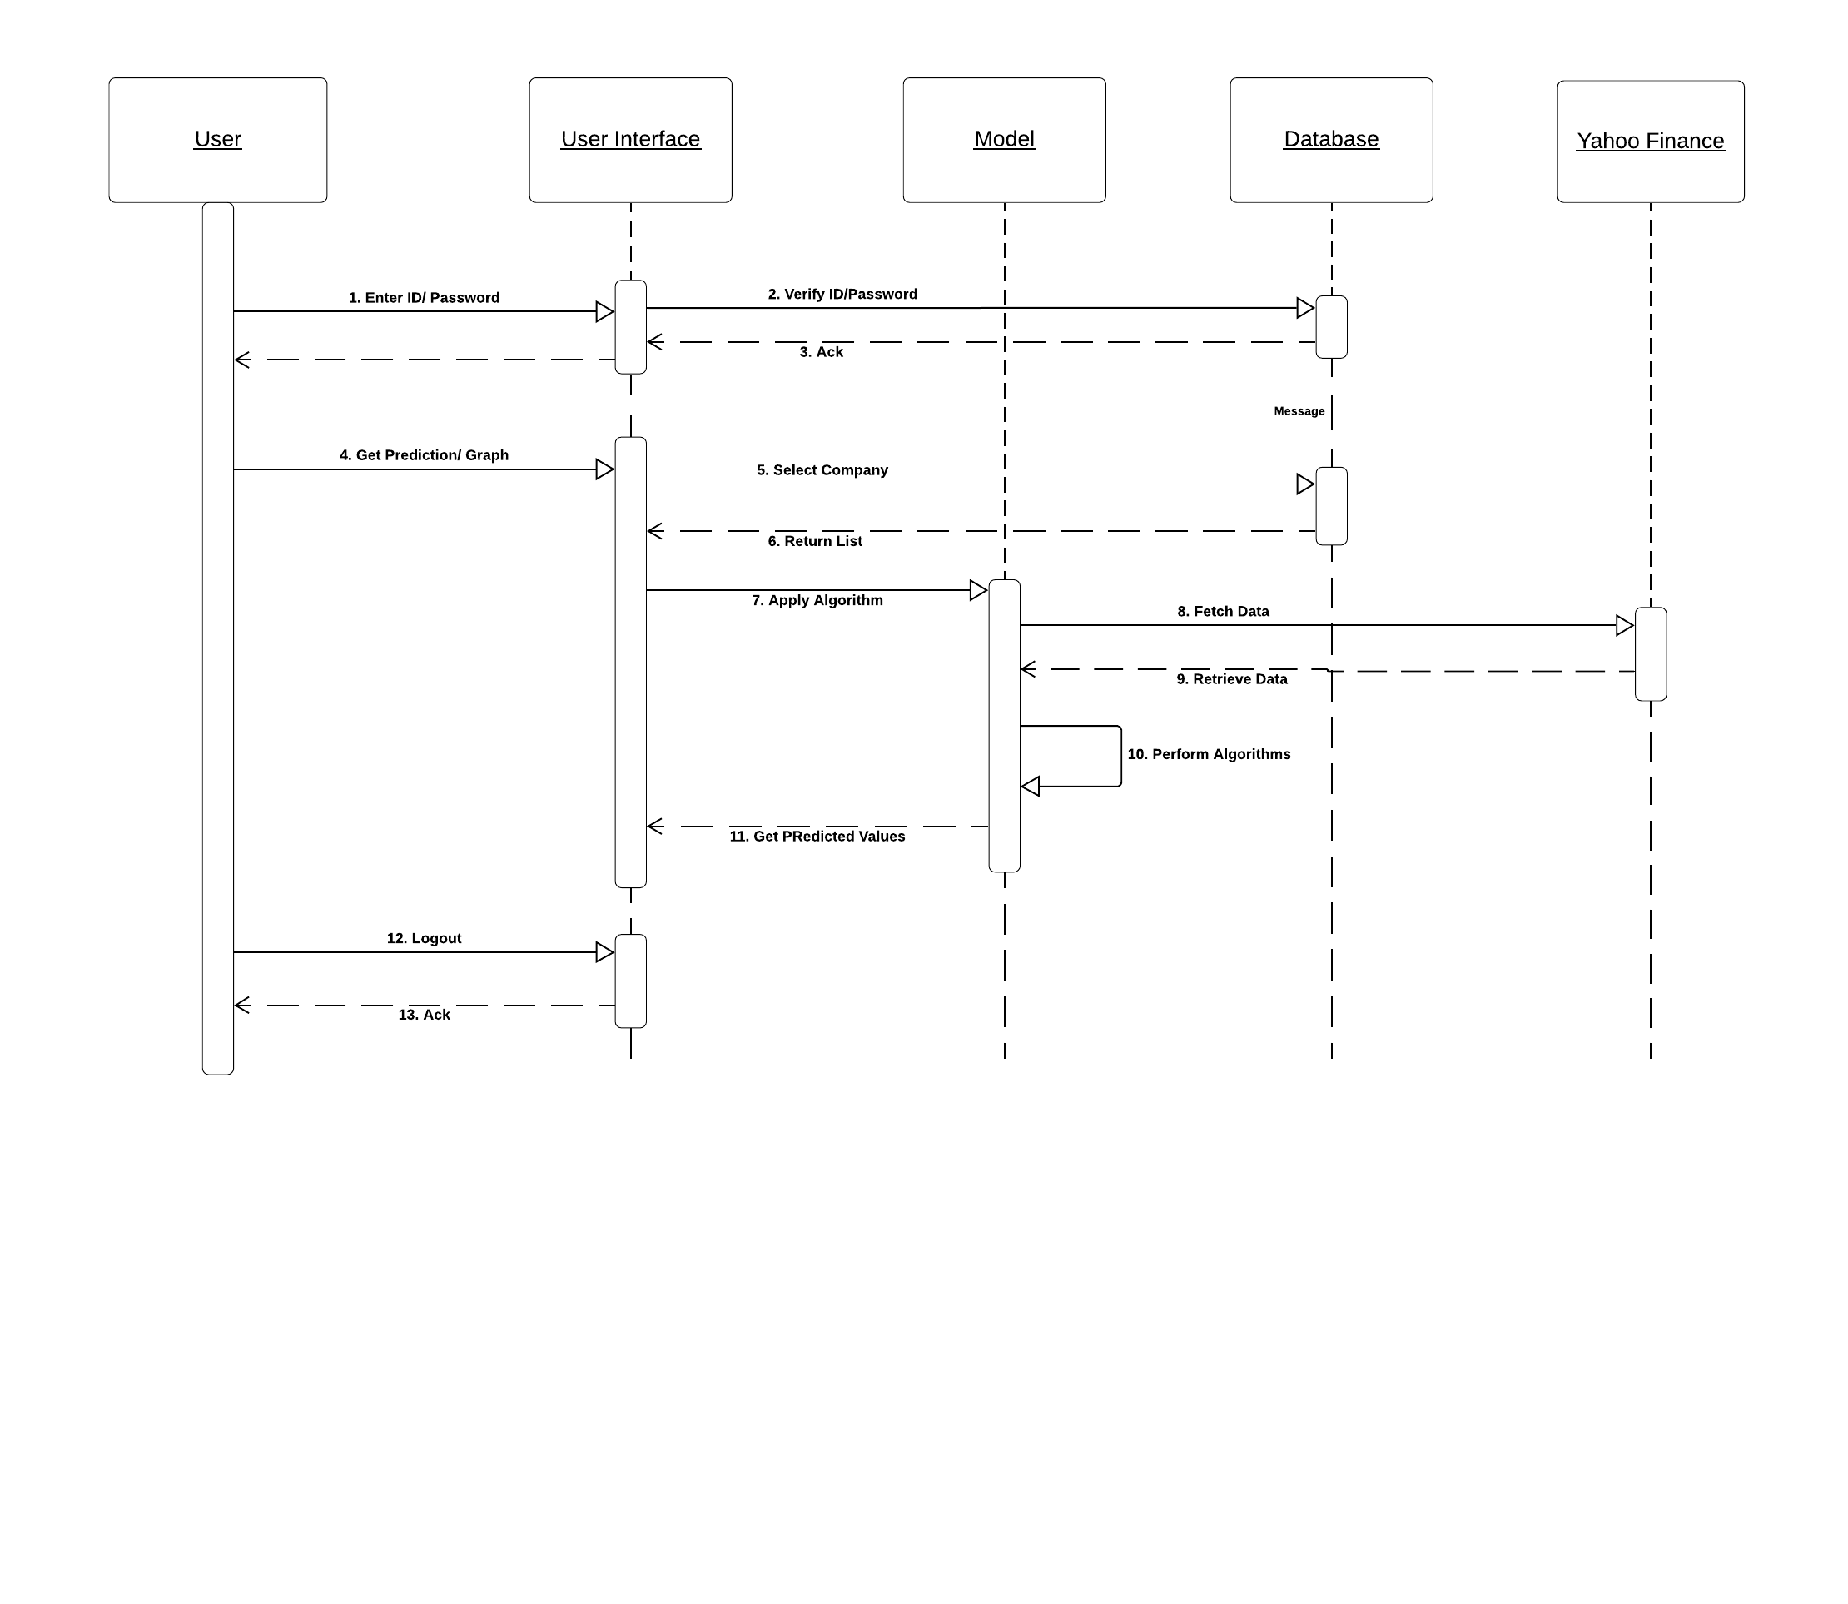
UML Diagrams : Sequence

Slide 16
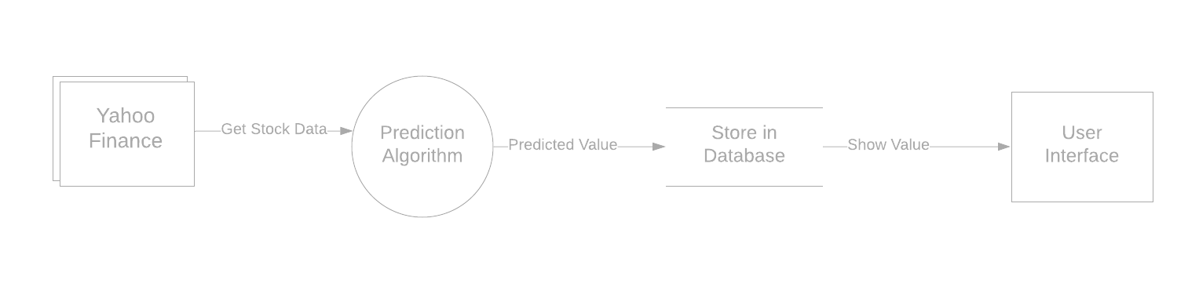
Data Flow Diagram(Level 0):

Slide 17
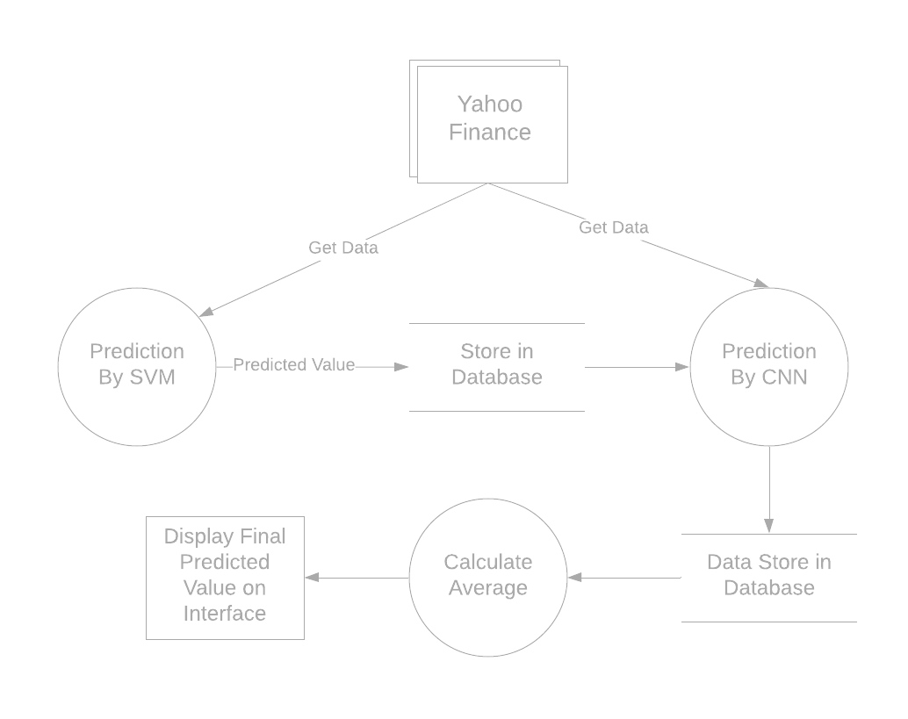
Data Flow Diagram(Level 1):

Slide 18
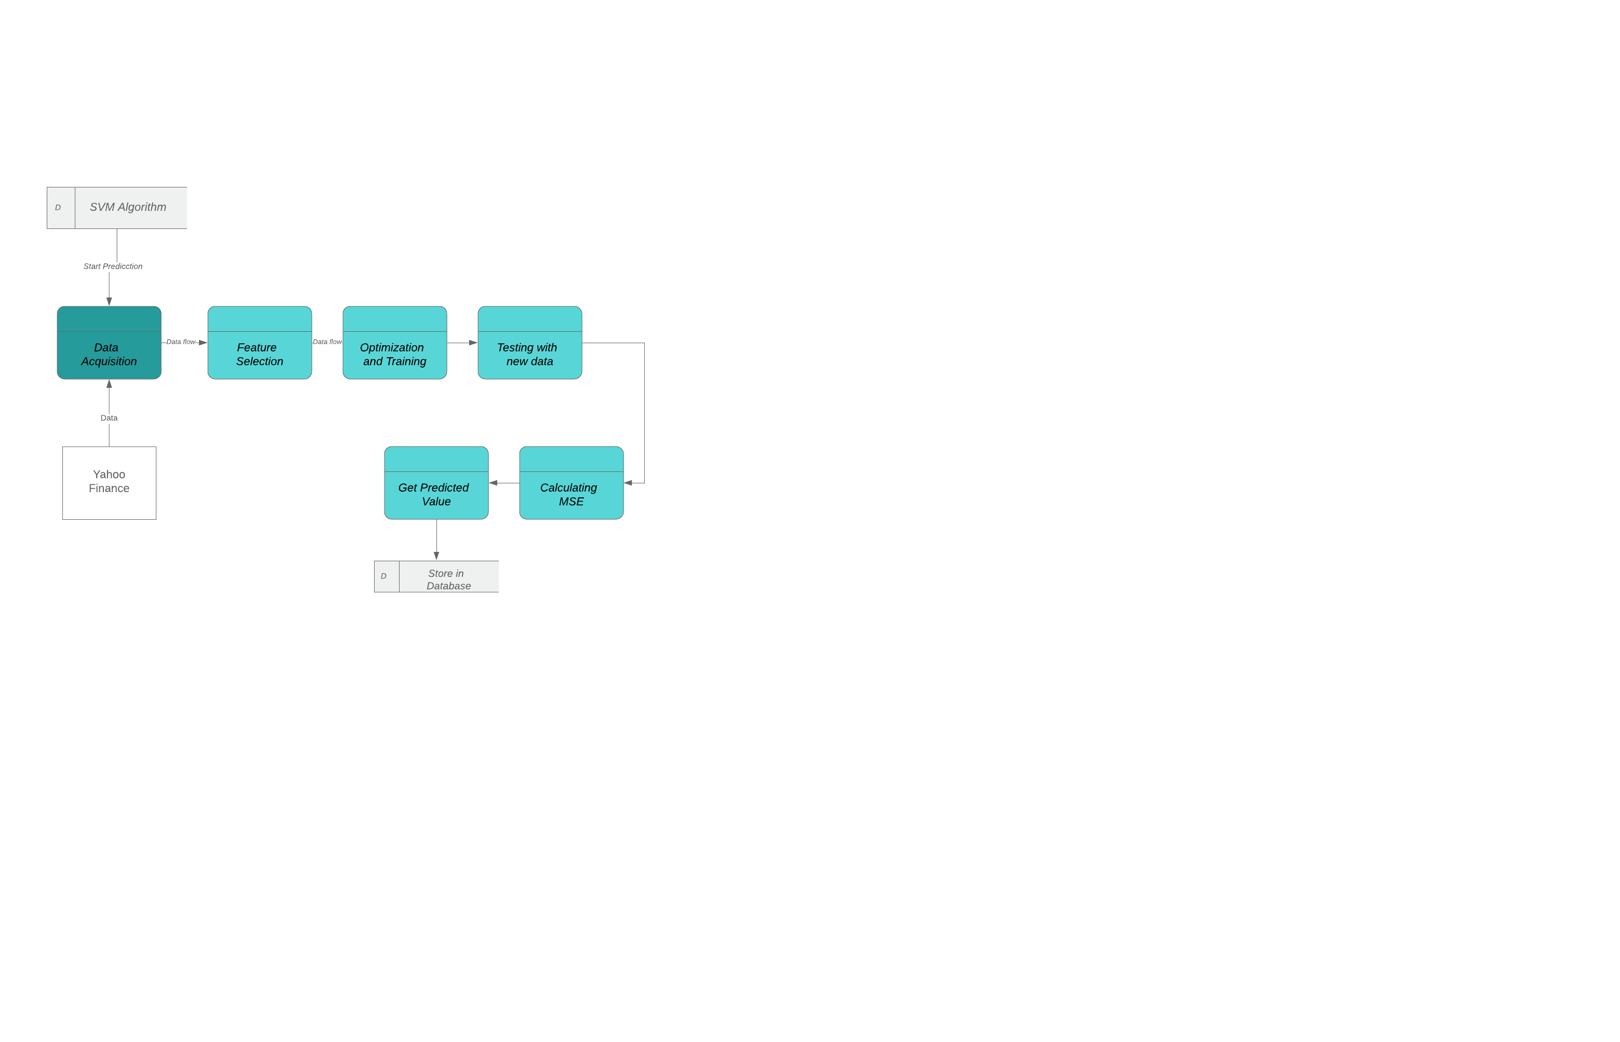
Architecture : SVM

Slide 19
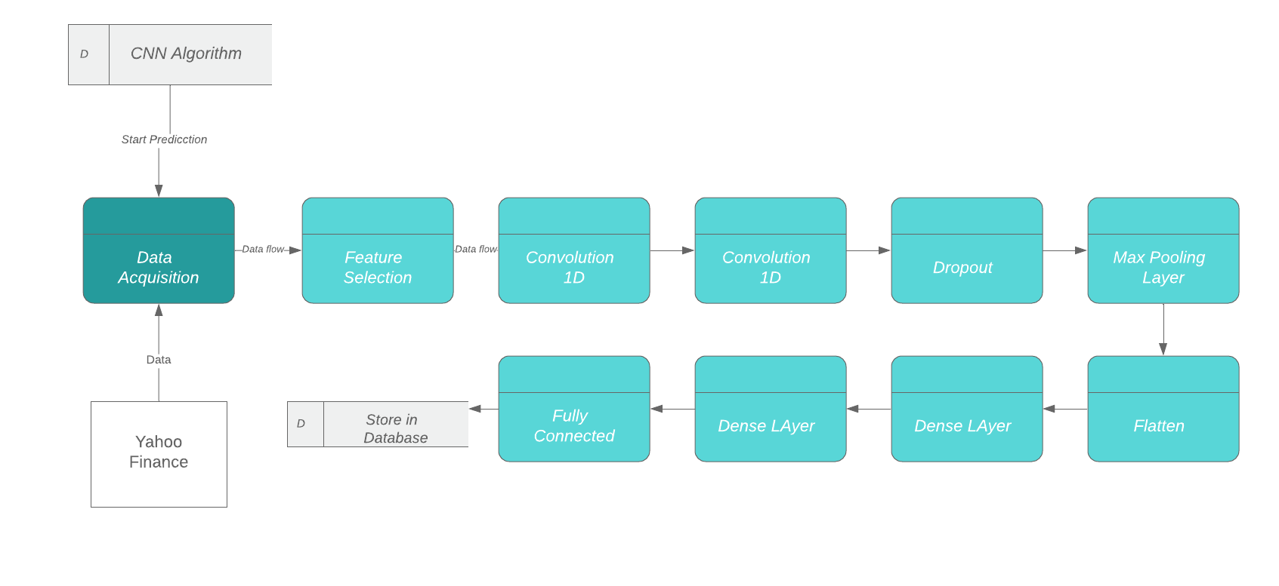
Architecture : CNN

Slide 20
Implementation Details : Dataset
The dataset consists of data of 3 companies TCS, Cipla and Infosys for the period 1st September 2013 to today.
The data is obtained from Yahoo Finance using pandas_datareader.
The features used are Open, High, Low, Close, Adjacent Close.
The data is fetched everytime the python script for prediction is run and is saved to a .csv file.
The dataset obtained from Yahoo Finance is split into training and testing set. 70% of data is used in training and 30% for testing.

Slide 21
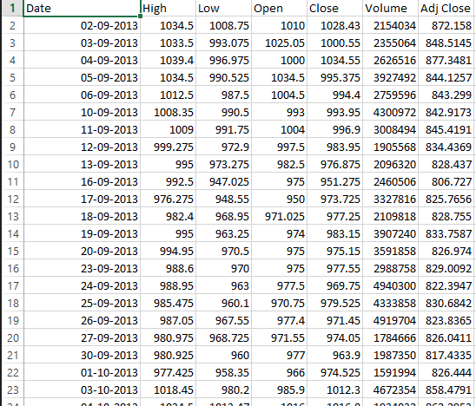
Implementation Details : Dataset

Slide 22
Implementation Details : Backend
The system uses Python 3.7 with idle integrated development environment for python.
The system uses XAMPP webserver for Apache server to host all the UI files and MYSQL database to store data.
The database (Name of Database: stock) consists of tables as follows:
1) Users: It stores the username, id, password, e-mail and contact number.
2) Prediction: It stores the predicted close value for a company by CNN and SVM.
The python script evaluates the predicted close price by CNN and SVM and it is inserted into the prediction table of MYSQL database for further use.

Slide 23
Implementation Details : Prediction module
The code for prediction of stock closing price are written in python.
The code must run once a day after the market closes. Everyday the values are updated into the .csv file used for storing data.
The prediction module applies two algorithms SVM and CNN for prediction of close price of next day.
The results from both the algorithm are averaged to get final predicted close value

Slide 24
Implementation Details : Code Snippet(CNN)
def conv1D(x_train,y_train,x_test):
def build_regressor():
verbose, epochs, batch_size = 0, 150, 16
n_timesteps, n_features, n_outputs = x_train.shape[1], x_train.shape[2], y_train.shape[1]
model = Sequential()
model.add(Conv1D(filters=64, kernel_size=3, activation='relu', input_shape=(n_timesteps,n_features)))
model.add(Conv1D(filters=64, kernel_size=3, activation='relu')) model.add(Dropout(0.5))
model.add(MaxPooling1D(pool_size=2))
model.add(Flatten())
model.add(Dense(100, activation='relu'))
model.add(Dense(n_outputs, activation='softmax'))
model.summary()
model.compile(loss='mean_squared_error', batch_size=batch_size, optimizer='adam', metrics=['accuracy'])

Slide 25
Implementation Details : Code Snippet(SVM)
SVM prediction model uses linear Support Vector Regression for predicting the stock value for the next day.
The cost value which is used for our prediction system is of 1, because it gives better results with this value and it gives the lowest value to our testing data.
def SVM_POS(x_train,y_train,x_test):
#Training the train data
from sklearn import svm
print ('Training the SVM Model...')
clr = svm.SVR(C=1,kernel='linear')
clr.fit(x_train, y_train)
print ('Training Completed.')
#Making predictions
y_predict=clr.predict(x_test)
return y_predict

Slide 26
Implementation Details : User Interface
HTML and CSS are used in creating GUI layouts.
PHP is used for database connectivity to update or fetch data from database.
The User Interface consists of Login/Register page.
A new user must register to interact with the system.
The homepage provides real-time feed of stock market related news.
User can then navigate to fetching current stock quotes, getting predicted values or visualizing trends in stock value via graphs plotted.

Slide 27
Results and Analysis
The approach is implemented on the stock prices for 3 companies : Infosys, Cipla and TCS.
The used data is fetched from Yahoo Finance that starts from the year 2013 to date.
The calculated results are obtained from both the algorithms, i.e. CNN and SVM.
A hybrid model approach is used where the final predicted value is the average value of both the models.
The average result obtained is observed to be more accurate(with an accuracy of above 95%) as compared to individual calculated values.
The result also includes a graphical representation of the predicted value.

Slide 28
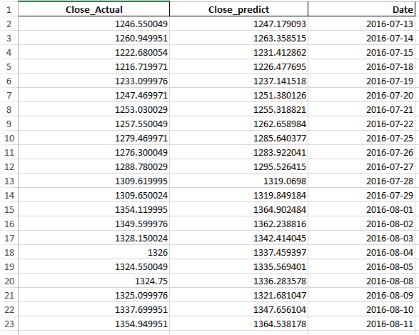
Results: Predicted values

Slide 29
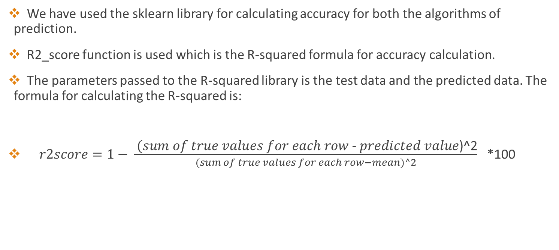
Evaluation metrics for the algorithms
We have used the sklearn library for calculating accuracy for both the algorithms of prediction.
R2_score function is used which is the R-squared formula for accuracy calculation.
The parameters passed to the R-squared library is the test data and the predicted data. The formula for calculating the R-squared is:
$r2score=1− \frac{ \text{(}\text{sum} \text{of} \text{true} \text{values} \text{for} \text{eac}\text{h} \text{row}\text{ - }\text{predicted} \text{value}\text{)}\text{^2}}{(sum of true values for each row−mean)^2}$ *100

Slide 30
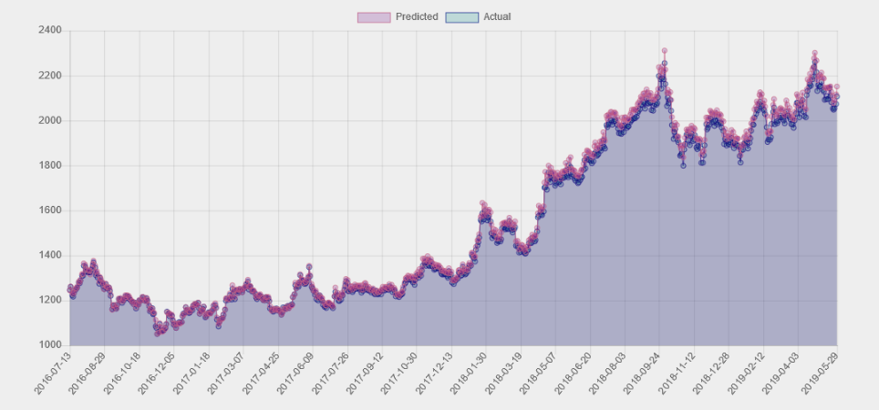
Fig: TCS : Actual and Predicted value using SVM
Graphs: Predicted values and Actual values

Slide 31
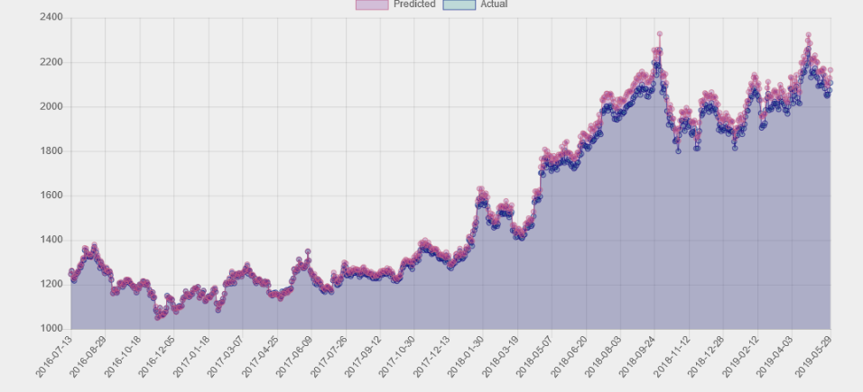
Graphs: Predicted values and Actual values
TCS: Actual and predicted value using CNN

Slide 32
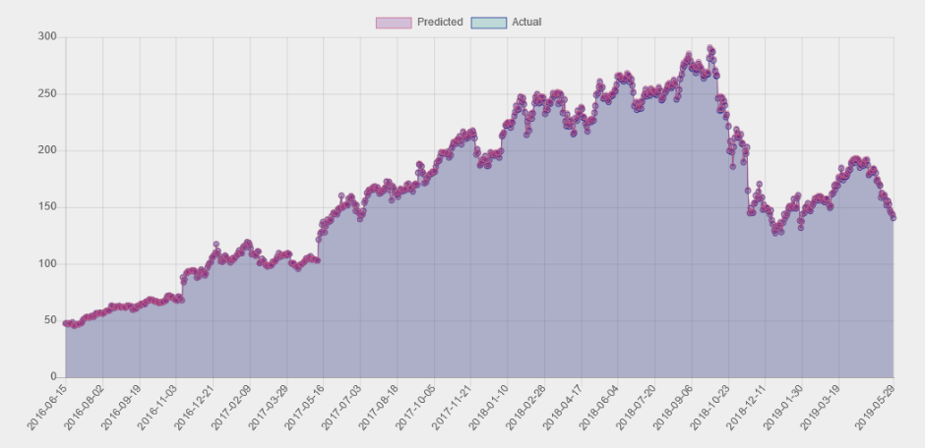
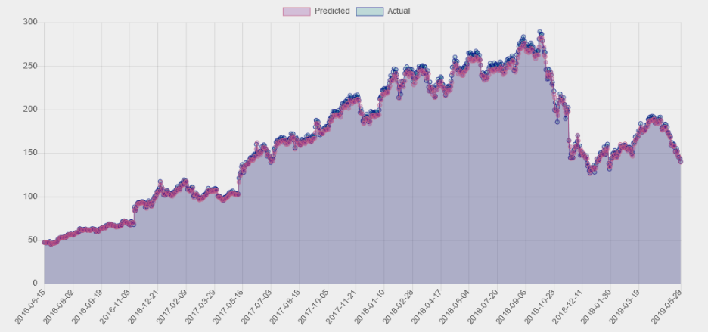
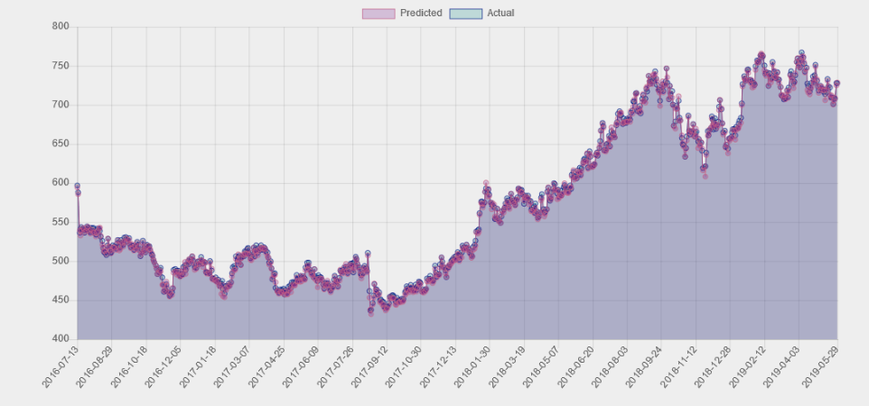
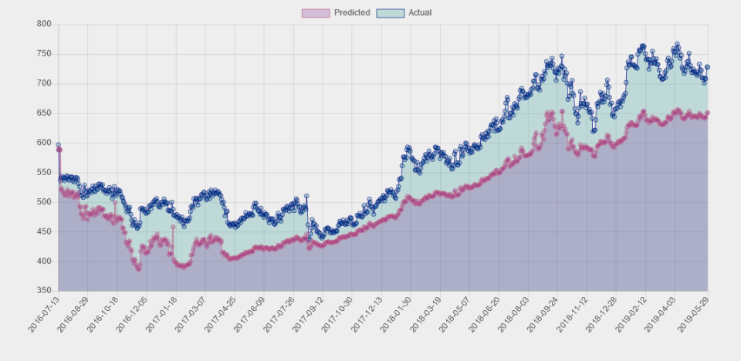
Graphs: Predicted values and Actual values
a)
b)
CIPLA: Actual and predicted value using a) CNN b)SVM
a)
b)
INFOSYS: Actual and predicted value using a) CNN b)SVM

Slide 33
Results: Accuracy
The value obtained by taking average of both the values generated individually by them, is much closer to the actual value of the particular Stock.
The accuracy of the proposed system is 99.5%

Slide 34
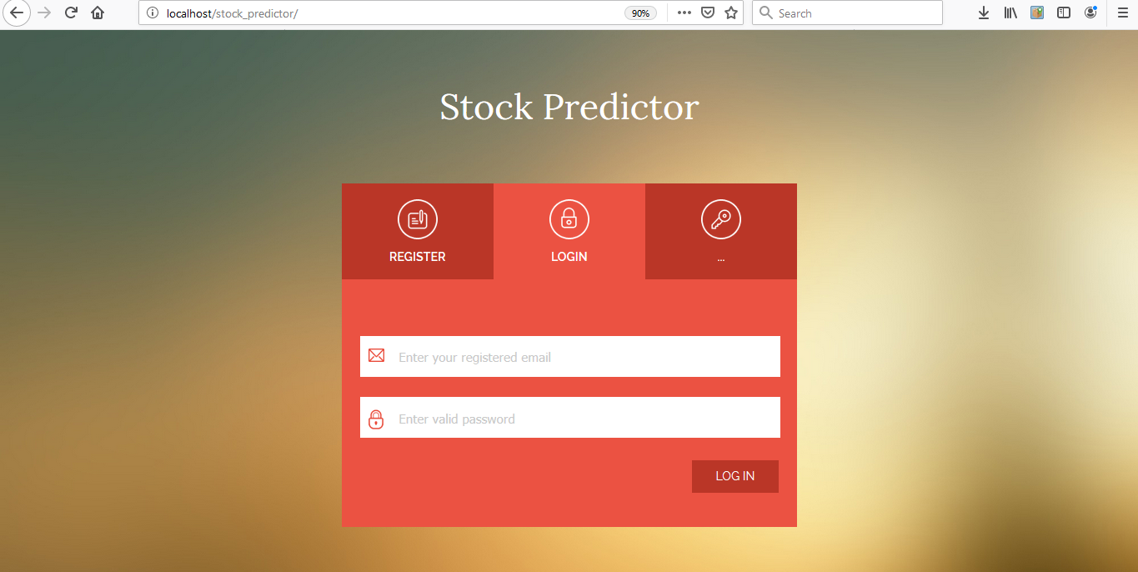
GUI snapshots : Login Page
Figure: GUI for login page

Slide 35

GUI snapshots : Registration
Figure: GUI for registration page

Slide 36
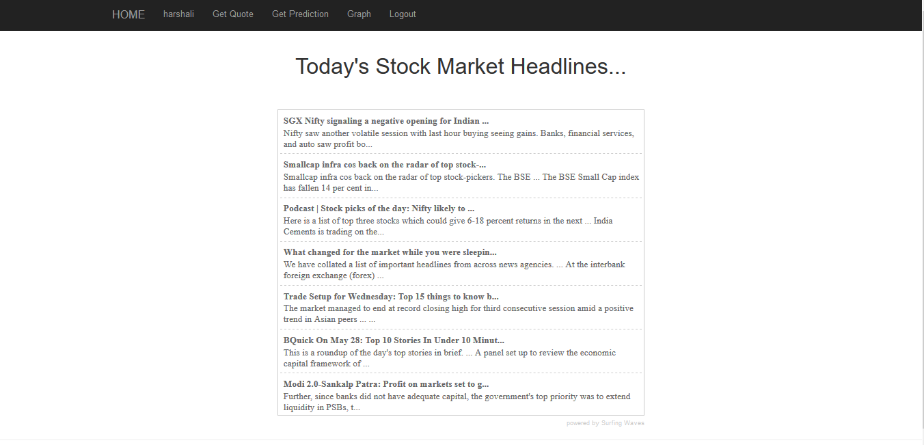
GUI snapshots : HomePage
Figure: GUI for homepage

Slide 37
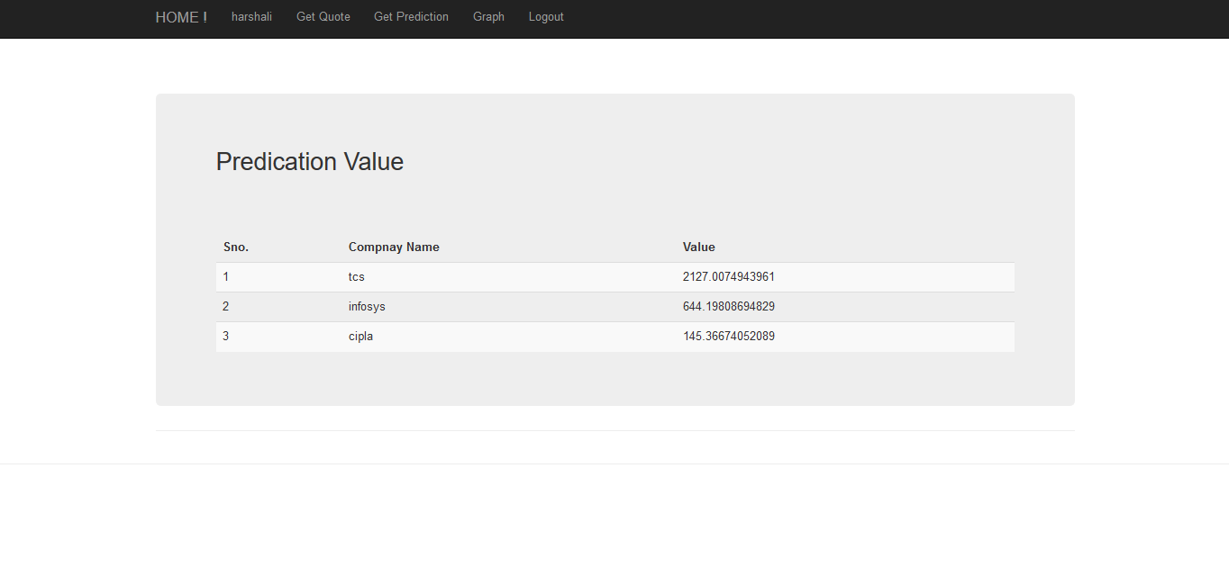
GUI snapshots : Get Predictions Page
Figure: GUI for Get Predictions page

Slide 38
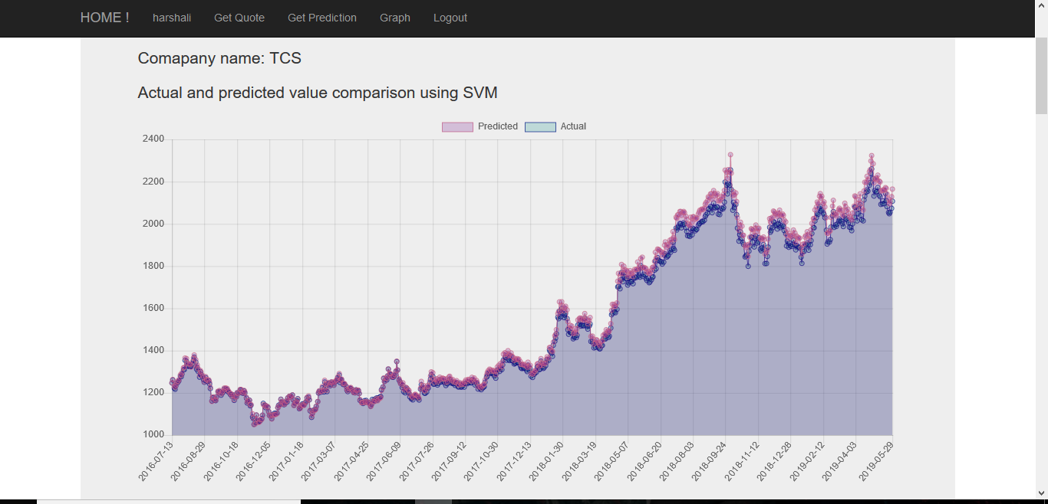
GUI snapshots : Get Graphs
Figure: GUI for Get Graphs page

Slide 39
Software Tools / Technologies
Technology/Tool | Platform | Use
HTML,CSS, Javascript | Windows | Web UI Development
XAMPP(MYSQL) | Windows | Backend Database
Python 3.0 | Windows | To run ML algorithms
Keras | Windows | For Deep Learning Algorithms
Matplotlib | Windows | To visualize the data properly
Scikit learn | Windows | Used for data mining
Numpy | Windows | Used for scientific computing

Slide 40
Hardware Requirements
Name | Use
PC/Laptop/mobile | To use the web based system
Other Requirements
***An active Internet Connection***

Slide 41
Outcomes
A efficient system for stock market prediction is developed.
A friendly Graphical User Interface for customers.
Better idea of varying stock prices using graphs.
Automated system; running scripts in timely manner to fetch real time data.

Slide 42
References
[1] Sreelekshmy Selvin, Vinayakumar R, Gopalakrishnan E.A, Vijay Krishna Menon, ‘STOCK PRICE PREDICTION USING LSTM,RNN AND CNN-SLIDING WINDOW MODEL’, International Conference on Advances in Computing, Communications and Informatics (ICACCI),IEEE, Udupi, India, Sept 2017
[2] Luca Di Persio , Oleksandr Honchar ‘Artiﬁcial Neural Networks architectures for stock price prediction: comparisons and applications , 2016
[3] Avraam Tsantekidis, Nikolaos Passalis, Anastasios Tefas, Juho Kanniainen, Moncef Gabbouj and Alexandros Iosiﬁdis ‘Forecasting Stock Prices from the Limit Order Book using Convolutional Neural Networks’

Slide 43
References
[4] Anastasia Borovykh Sander,Bohte, Cornelis W. Oosterle ‘Conditional time series forecasting
with convolutional neural networks’ June 2018
[5] Trevor M. Sands, Deep Tayal, Matthew E. Morris, and Sildomar T. Monteiro,’ Robust Stock Value Prediction using Support Vector Machines with Particle Swarm Optimization’, 2015 IEEE Congress on Evolutionary Computation (CEC) , IEEE, Sendai, Japan, May 2015
[6] Osman Hegazy, Omar S. Soliman and Mustafa Abdul Salam, ‘A Machine Learning Model for Stock Market Prediction’ , International Journal of Computer Science and Telecommunications , Egypt, December 2013

Slide 44
References
[7] M. Karazmodeh, S. Nasiri, and S. Majid Hashemi, ‘Stock Price Forecasting using Support Vector Machines and Improved Particle Swarm Optimization’, Journal of Automation and Control Engineering, North Cyprus, Turkey, June ,2013
[8] http://faganasset.com/2015/04/16/if-not-the-stock-market-then-where/
[9] cs231n.github.io/convolutional-networks/
[10] deeplearning4j.org
[11]https://en.wikipedia.org/wiki/Stock_market

Slide 45


